Slide 1
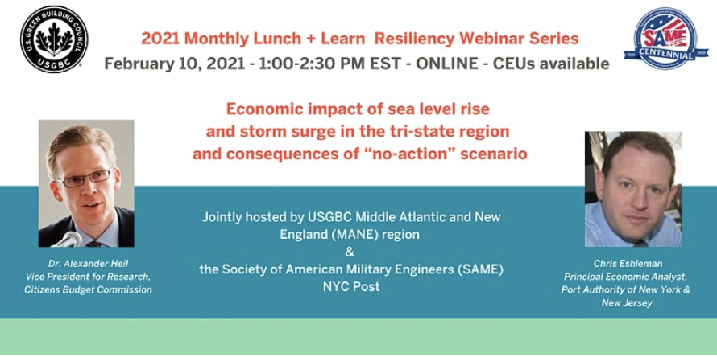
The consequence of facility shutdowns
Economic impact of sea level rise and storm surge in the tri-state region and consequences of “no-action” scenario.

Slide 2
Economic Disruption
Learning objectives:
Review economic estimates of shutdown of various Port Authority of New York and New Jersey facilities from severe weather events.
Contextualize the need to protect against events and frame that need against competing needs.
Potential uses include comparison of avoided economic damages with cost of protection.
Notes:
Public managers and lawmakers regularly need to prioritize infrastructure projects or make discrete yes/no decisions on a project.
The business case for those projects can be soft and qualitative or can be data-driven and formal, or anything in between.
Climate-resilience projects aim to protect infrastructure, not only to avoid physical damage but also to protect the service those assets provide. Managers face the question of how to quantify the value of protecting those services.
This is not a challenge that’s easy to answer but methodology from social cost-benefit analysis provides the means to rationally value those services. This helps decision makers understand the value a given resilience project can provide.

Slide 3
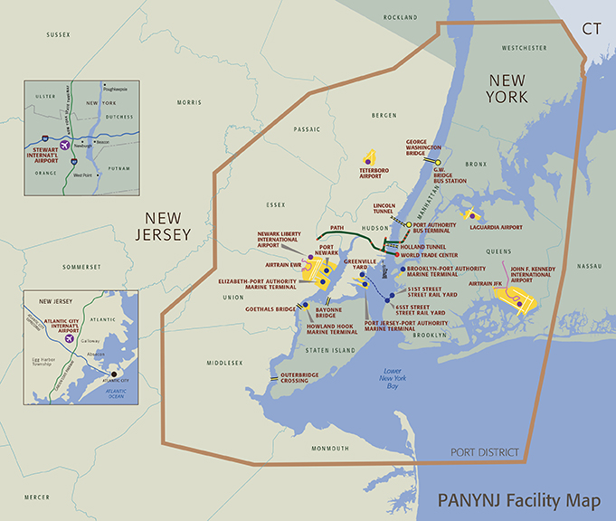
Port Authority of NY & NJ Facilities
Notes:
3 Focus on the Port Authority region, which comprises 18 counties. Many actual and potential climate resilience projects undertaken or in the works and estimates to follow can help with decisions on any of them.

Slide 4
Economic Disruption Estimates - Rationale
Events such as storms or weather events can negatively affect infrastructure and facilities resulting in their temporary closure
Damage from events usually result in specific asset destruction requiring maintenance and rebuilding
The estimates presented in this document cover not the monetary values of asset destruction but rather the economic consequences from not operating real estate assets, maritime, transit or road transportation facilities
Notes:
4 More about challenge facing decision-makers. Events such as storms or weather events can negatively affect infrastructure and facilities resulting in their temporary closure. Easier to estimate monetary physical damage from events. Harder to conceptualize impact on asset’s ability to do its job. Second part often left unquantified and treated as fuzzy thing of secondary importance. Financial streams such as revenue make poor substitutes for operations, as large infrastructure generally exists outside of marketplaces that would allow for valuation of asset (obvious exception is large commercial or residential real estate).

Slide 5
Economic Disruption Estimates - Rationale
… not the monetary values of asset destruction but rather the economic consequences from not operating real estate assets, maritime, transit or road transportation facilities
Opportunity Costs: This refers to lost economic activity, or opportunities, that arise when a business or society pursues one product or strategy over another.
Notes:
5 Valuing the services an asset provides involves estimating the market value people might put on having it. The language for this type of analysis generally focuses on opportunity costs. Constructing and maintaining infrastructure diverts resources from other investments or from consumption. Thus, each investment has a cost. This cost is either associated with the return that could be earned on the next-best use of capital (known as the opportunity cost of capital) or with the rate of return (the productivity of capital) that must be paid to induce people to defer an additional unit of current consumption. We use this to estimate the value of having an asset compared to its absence.

Slide 6
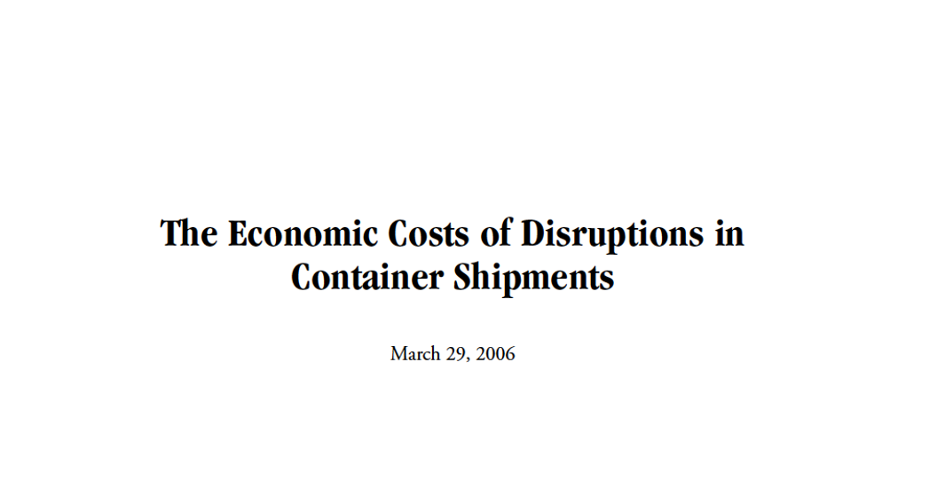
Economic Disruption Estimates - Rationale
Select precedent:
Congressional Budget Office Analysis.
Notes:
6 This type of analysis — valuing the services a program provides or an asset promises — gets used all the time. It’s not very visible. The federal government has required it since the Reagan Administration. It’s generally at play for major federal grant programs. Fourteen years ago a group of US Senators asked staff for a public accounting of services lost during a West Coast port labor strike. That methodology helped inform the work at focus today, which we did roughly a decade later.

Slide 7
Goals of the Economic Disruption Study Effort
To estimate the economic impact of a facility closure.
The economic impacts include:
  Additional Travel Time For Passengers/Drivers
  Increased Delay for Freight
    Travel Time of Freight
    Spoilage and Productivity Impacts of Slower Freight
  Impacts on Employers Due to Productivity Loss
  In general: Impacts on economic activity not asset damage!
Notes:
7 When we evaluated our facilities, we had a few obvious data points that needed collecting. How to measure the operational benefits of a physical asset? Key is to develop a counterfactual: imagine life without it. Then take the net change of life with and without that asset for a set amount of time. Transport infrastructure improves transportation so its absence makes transportation more difficult. This is measured primarily in hours spent traveling. Other metrics are specific to transport safety and environmental impact (air pollution).

Slide 8
Economic Disruption Estimates –
Basic Assumption
The disruption impacts are limited to the facility being analyzed (i.e. PATH does not work, but NJTransit does)
The delays are calculated for 1,3,7 and 30 day periods and includes changes in user behavior based on length of disruption.
The analysis does not assume any other impacts to the economy. Facilities are down, but it is business as usual everywhere else.
Notes:
8 Analysis need to reduce the moving parts to isolate asset value. Example: assume sister infrastructure and sister agencies are protected from storms – turn those light switches on, then measure the differences in travel when switching the PANYNJ-specific infrastructure switches from on to off. Also fix the amount of time under analysis. Took discrete snapshots of on-off switch analysis at one period of time. Then redid it for another period of time. Some of analysis changes in nonlinear fashion across differences, but generally same.

Slide 9
Economic Disruption Estimates –
Summary of Findings
Facilities that do not have local alternatives generate larger impacts on the region (Port and Airport)
The additional travel time is the major economic impact factor for local transportation facilities
In several cases, longer delays equate to lower average daily impacts.
Notes:
9 Other assumptions: unless noted differently, the spillover effects in the form of additional delays and congestion on other models are also not included. For instance, a shutdown of PATH
service may incentivize travelers to use automobiles and add to the existing congestion
at other crossings. While likely significant, we have not considered such compounding
effects. In fact, the estimates presented in this memo have been derived by applying
partial equilibrium analysis without the use of any travel demand modeling. The estimates consider the aggregate impacts of facility closures on the regional
economy without taking into consideration distributional effects. For instance, if
employees cannot or otherwise do not physically commute following an event and
instead work remotely during the study’s time horizon, employers may incur
productivity losses while commuters may benefit from having more time available for
non‐work activities.
We accounted for remote work. We have assumed that some workers will not physically commute immediately after the disruption. However, over time, commuters are assumed to ease their reliance on remote work and resume physical travel to their respective workplace. On the other hand, we have assumed that over time workers increase their remote productivity because they learn how to create a better work environment, adapt to the lack of an office environment and utilize tools such as remote networking and cloud
computing access to an increasing degree.

Slide 10
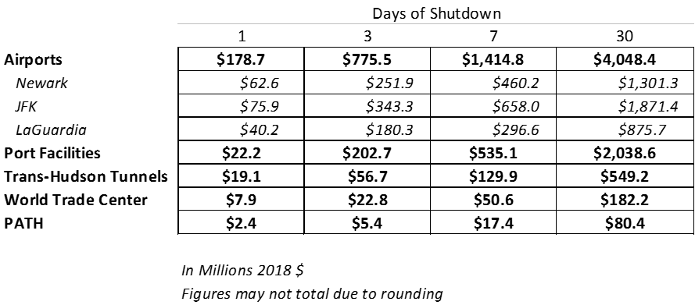
Summary: Total Economic Consequences
By Facility
Note: figures represent estimated damage to economy from facility shutdowns.
Notes:
10 Table summarizes impacts by type of business operation. It excludes physical damages — it’s just the impact to business operations.

Slide 11
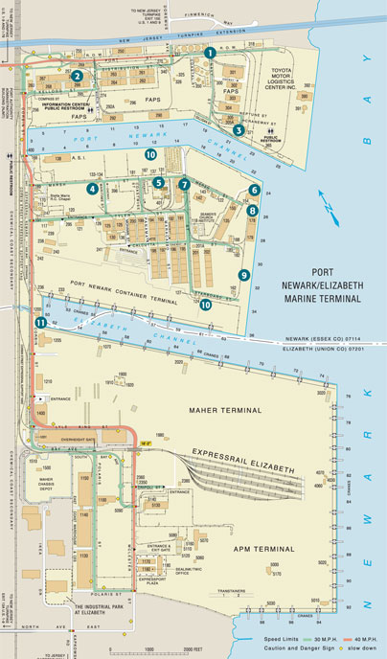
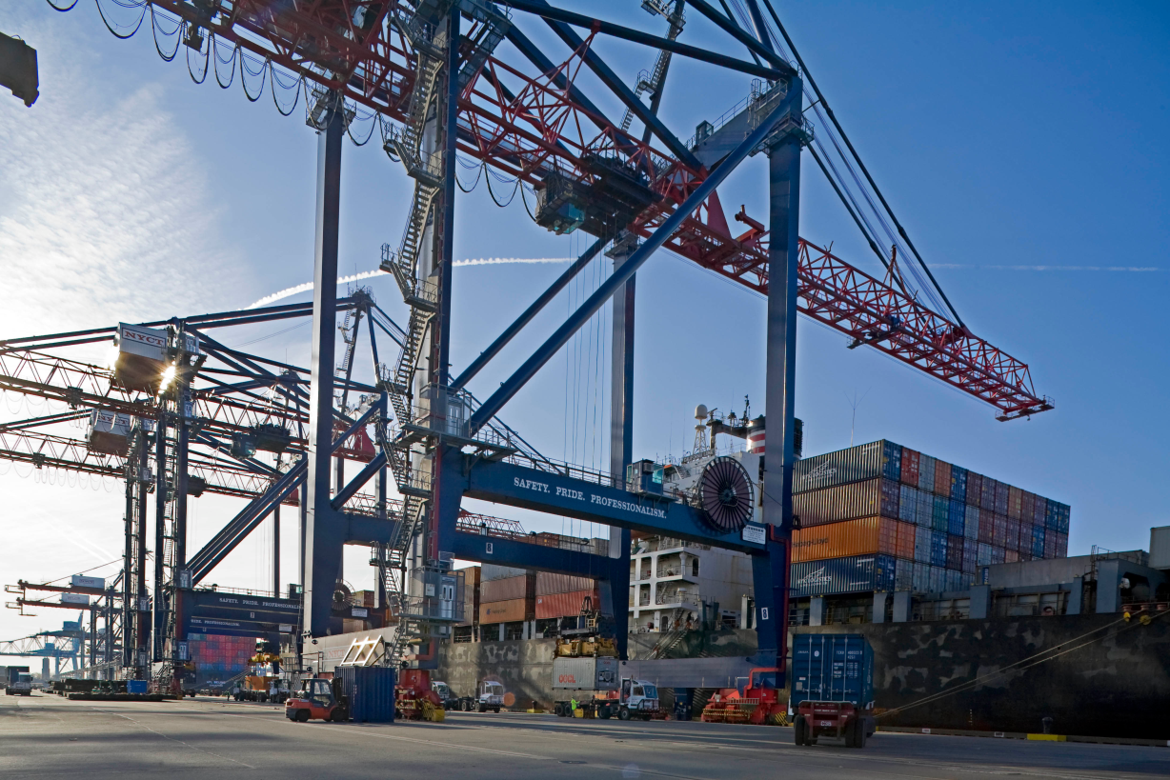
Port Facilities
Notes:
11 There are four container terminals in the port, whose combined volume makes it the largest on the East Coast and the second busiest in the United States. PANYNJ leases the terminals to operators, such as A.P. Moller-Maersk Group, NYCT, and Global Marine Terminal. The port also accommodates bulk shipments of road salt and breakbulk goods, as well as some cruise ship activity.

Slide 12
Port Facilities Shutdown Estimates-Summary
Economic Consequences result from a variety of impacts
  Delay within logistic chain
  Transportation Costs due to rerouting of cargo
  Destruction of cargo such as perishable goods and automobiles
  Additional staff costs for PA and terminal operators
Notes:
12 Port damages focus largely on supply chain impacts. Only operation to focus primarily on goods. Accounts for all stakeholders — manufacturers, shipping community, ground transport, consumers.

Slide 13
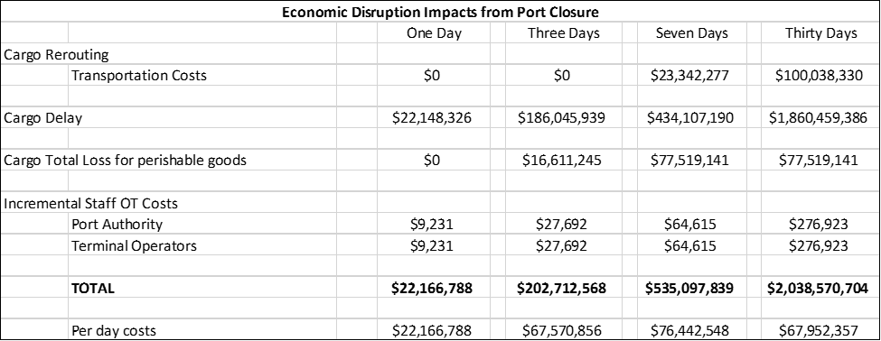
Port Facilities Disruption Economic Impacts – Impact Summary
Notes:
13 Cargo delay accounts for significant impact. Spoilage of goods is minor consideration that only applies in longer shutdown scenarios. Rerouting is not considered in short-run scenarios but does work its way into longer scenarios.

Slide 14

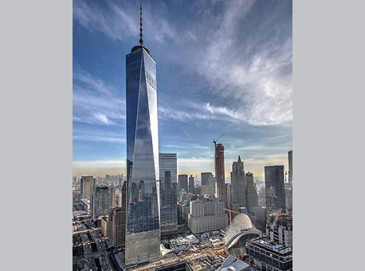
World Trade Center
Notes:
14 “The World Trade Center is a mostly completed complex of buildings in Lower Manhattan, New York City, U.S., replacing the original seven buildings on the same site that were destroyed in the September 11 attacks. The site is being rebuilt with up to six new skyscrapers, four of which have been completed; a memorial and museum to those killed in the attacks; the elevated Liberty Park adjacent to the site, containing the St. Nicholas Greek Orthodox Church and Vehicular Security Center; and a transportation hub. The 104-story One World Trade Center, the tallest building in the Western Hemisphere, is the lead building for the new complex.”

Slide 15
World Trade Center Site (WTC)- Summary
Basis for all scenarios: This study looks at affected business activity on site, specifically:
office employment
retail employment and sales
disturbances in economic activity due to PATH closures.
Commuter delay and productivity losses due to office employees staying home are the largest impacts of the disruption. Productivity losses are minimized by applying a productivity function for working at home.
 | 1 day | 3 days | 7 days | 30 days
Office labor (wages) | $4,406,659 | $12,803,964 | $27,934,520 | $90,737,116
Retail losses (wages and sales) | $2,216,097 | $6,648,292 | $15,512,681 | $66,482,919
PATH (wages and travel delay)
Alternative route | $729,076 | $2,187,227 | $5,103,529 | $21,872,267
Remote work | $565,184 | $1,182,379 | $2,092,860 | $3,059,820
Total Cost | $7,917,016 | $22,821,861 | $50,643,590 | $182,152,122
Per day | $7,917,016 | $7,607,287 | $7,234,799 | $6,071,737
Notes:
15 WTC was complex, as needed to account for multiple uses at WTC site. Significant office space. Retail shops underneath site. PATH station built in. Commuter delay and productivity loss from temporary loss of office space amounted to biggest impact. Retail was minor. We developed estimate of net productivity losses (accounting for ability to work from home) to finish estimates.

Slide 16
World Trade Center Site (WTC)- Assumptions
WTC = One WTC, 2 WTC, 3 WTC, 4 WTC, the PATH transportation hub, and Westfield shopping center.
Assumptions:
Entire site shuts down; entire site comes back online at the end of each timeframe
WTC PATH shuts down -> Exchange Place shuts down
All WTC office employees work from home, following an exponential function
10% of non-WTC employees taking PATH at affected station end up working from home
All WTC employees stay home, but only 90% of them are able to WFH
8% of the PATH riders at the WTC station work at the WTC site
One WTC occupancy rate = 70%
Year of analysis is 2020 - construction is completed
Add on 50% employer benefits to BLS wage data
Working from home productivity – 50% on day 1, maxes out at 75%-90% by day 21
COVID has provided a new data point here!
Notes:
16 Broader assumptions:
Entire site shuts down; entire site comes back online at the end of each timeframe
WTC PATH shuts down -> Exchange Place shuts down
All WTC office employees work from home, following an exponential function
10% of non-WTC employees taking PATH at affected station end up working from home
All WTC employees stay home, but only 90% of them are able to WFH
8% of the PATH riders at the WTC station work at the WTC site
One WTC occupancy rate = 70%
Year of analysis is 2020 - construction is completed
Add on 50% employer benefits to BLS wage data
Working from home productivity – 50% on day 1, maxes out at 75%-90% by day 21
COVID has provided a new data point here!

Slide 17
WTC Disruption Impact Summary
 | 1 day | 3 days | 7 days | 30 days
Office labor
wages lost, remote | $8,012,107 | $24,036,322 | $56,084,751 | $240,363,220
wages lost, remote with productivity | $4,406,659 | $12,803,964 | $27,934,520 | $90,737,116
Retail losses | $2,216,097 | $6,648,292 | $15,512,681 | $66,482,919
PATH
World Trade Center Employees | n/a | n/a | n/a | n/a
non-World Trade Center alternative route | $729,076 | $2,187,227 | $5,103,529 | $21,872,267
non-World Trade Center employees, remote | $1,130,369 | $2,439,610 | $4,633,474 | $7,853,501
non-WTC employees, remote with productivity | $565,184 | $1,182,379 | $2,092,860 | $3,059,820
Total Cost
no remote productivity | $12,087,649 | $35,311,451 | $81,334,436 | $336,571,907
with remote productivity | $7,917,016 | $22,821,861 | $50,643,590 | $182,152,122
with remote productivity/day | $7,917,016 | $7,607,287 | $7,234,799 | $6,071,737
Notes:
17 Re-ran with and without remote productivity assumptions.

Slide 18
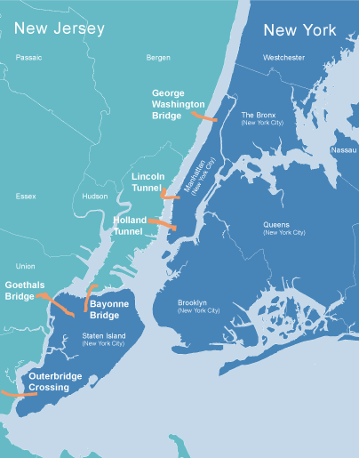


PA Trans-Hudson Tunnels
Notes:
18 The Hudson and Lincoln tunnels are PANYNJ’s two submerged vehicular tunnels beneath the Hudson River. (Different from the rail tunnels to the north, which carry Amtrak and NJ Transit trains.) Holland carries traffic from Interstate 78 into Manhattan and Lincoln is part of Route 495. PANYNJ also operates George Washington Bridge to the north, but experience with Hurricane Sandy = assumed bridges and access generally protected, focused on tunnels.

Slide 19
Tunnel Facilities Disruption Summary
Low truck volumes at the tunnels equate to low freight delay impacts
  No Heavy Trucks allowed at Holland
  Only 5% of PA Heavy Trucks travel in Lincoln
Commuter delay and productivity losses are the largest impacts of the disruption
Notes:
19 Decision to focus on tunnels minimized impact on freight. This narrows focus to commuters, who have other options (PATH, for example).

Slide 20

Tunnel Facilities Disruption Summary
Notes:
20 Sandy significant physical damage to tunnels. The Holland Tunnel was closed on October 29, 2012, as Sandy approached. Remained closed for several days, opening for buses only on November 2 and to all traffic on November 7. That week-plus shutdown is the type of impact we’re focusing on today: the non-physical damage.

Slide 21
Tunnel Facilities Disruption Assumptions
For Personal Travelers
Anticipated users of the tunnel facilities:
  Most still come to work even if the tunnels are not operational assumes other alternatives
    25% will work from home
    In 2 Weeks, 100% will be back at work
    Those working from home will have less productivity
  Differences in drive times are based on Census journey to work by county to Manhattan (differences = mass transit times-drive times), 33 minute delay each way
  User costs are based on reasons for use via TB&T survey: recreation, commuter, business
  Assume 50% of recreational tunnel users choose not to go into Manhattan
  Assumes average traffic is similar to 2016
Notes:
21 Apply some of same assumptions as in WTC and PATH. Most keep physically coming to work. A portion work remotely. Productivity is adjusted. Different assumptions for leisure travelers, who have different elasticities built into travel decision, than commuters. Drive times use centroids for handful of origin counties and central Manhattan — published data on weighted average of drive times.

Slide 22
Tunnel Facilities Disruption Assumptions
For Freight
Anticipated Freight users of the tunnel facilities:
  Although only a small portion of tunnel traffic, trucks would utilize other facilities to reach their NY destination derived from the TB&T OD Truck Survey
  Round trip estimated with $47 value of time. VOT includes inventory adjustments
  Differences in drive times are based on alternate facility usage and county center point drive times and assume center point Manhattan as the destination
  Drive time changes are for Non-Tunnel alternative route, 20 minute delay in traffic
Notes:
22 Freight analysis can be treated similar to passenger analysis, impacts then sutured together for results. Freight valued differently at hourly level, and value of freight has its own dollar figure (added to driver value). Different assumptions regarding vehicle occupancy, emissions, vehicle operating costs, fuel consumption.

Slide 23
Tunnel Facilities Disruption Impact-
Passenger Impact Summary
 | Daily Avg. | 3-Day | Weekly | Monthly
Total Vehicles | 94,964 | 284,893 | 664,749 | 2,848,926
Autos | 84,379 | 253,137 | 292,983 | 2,531,372
Bus | 6,461 | 19,383 | 26,958 | 193,827
 | Costs For Passengers (in hours)
Business | 17,667 | 53,001 | 123,668 | 530,006
Commuter (Net Commuter/Non-Commuter Time) | 35,355 | 117,021 | 324,181 | 2,629,945
Personal (assumes 50% loss) | 31,589 | 94,768 | 221,126 | 947,685
 | Costs For Passengers (One Way)
Business | $468,172 | $1,404,516 | $3,277,204 | $14,045,161
Net Commuter Costs* | $3,912,833 | $11,441,683 | $25,516,477 | $103,960,405
Recreation | $467,524 | $1,402,573 | $3,272,671 | $14,025,733
Total | $4,848,530 | $14,248,772 | $32,066,352 | $132,031,300
Two Way Traffic | 9,697,059 | 28,497,544 | 64,132,704 | 264,062,600
Impacts Due to Productivity Loss | $2,850,553 | $7,721,116 | $14,548,792 | $20,524,889
10% Congestion Premium | $684,651 | $2,077,643 | $4,958,391 | $24,353,771
Total Impacts to Person Users | $10,381,710 | $30,575,187 | $69,091,096 | $288,416,371
Notes:
23 Final step involves recognition of network effects. Re-routing people and goods means congestion for alternative routes. Include rule-of-thumb adjustment for congestion.

Slide 24
Tunnel Facilities Disruption Impact-
Freight and Total Impact Summary
Freight Impacts | Daily Avg. | 3-Day | Weekly | Monthly
Truck Traffic | 4,124 | 12,373 | 28,870 | 123,727
Increase in Total Freight Time (in Hours) | 82,484 | 247,453 | 577,390 | 2,474,530
Total Value of Freight Time (One Way) | $3,951,825 | 11,855,474 | $27,662,773 | $118,554,743
Total Value of Freight Time (Round) | $7,903,650 | 23,710,949 | $55,325,547 | $237,109,486
10% Congestion Premium | $790,365 | 2,371,095 | $5,532,555 | $23,710,949
Total Freight Impacts | $8,694,014 | 26,082,043 | $60,858,101 | $260,820,434
Notes:
24 Freight small portion of travel but big portion of economic loss.

Slide 25
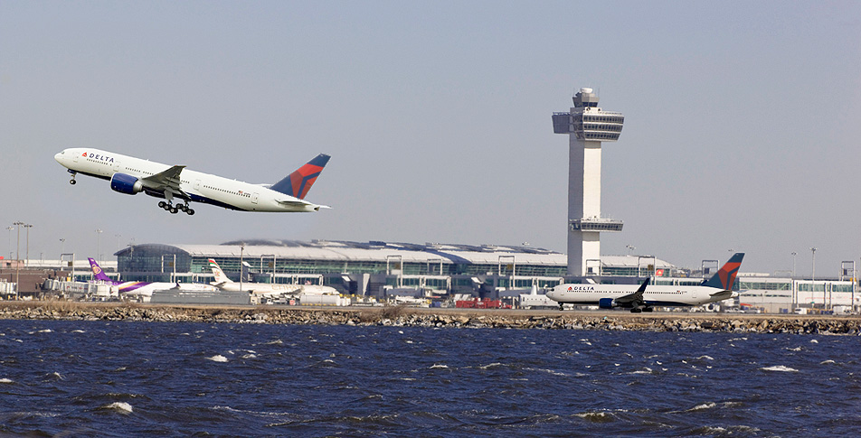

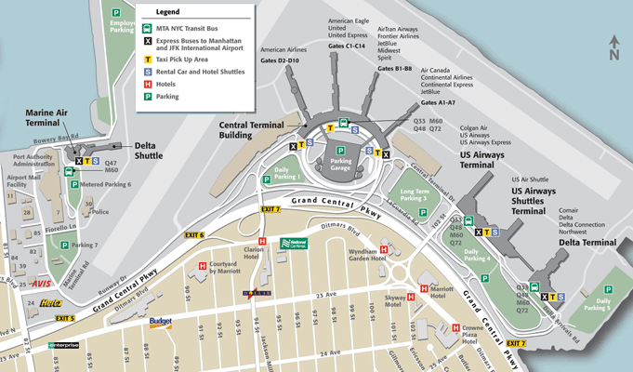
Port Authority Airports
Notes:
25 PANYNJ owns all three major airports (JFK, Newark, LaGuardia) in New York metropolitan area plus three smaller airports (Stewart, Teterboro, Atlantic City). Metro area has the busiest airport system in the United States. Also the most frequently used port of entry and departure for international flights, mostly through JFK. Airspace and slots are extremely congested.

Slide 26
Airport Disruption Summary
The economic consequences of airport shutdowns are largely driven by the inconvenience to passengers
The airlines face steep impacts due to lost profits
There are also large freight considerations, though these are assumed to level off at a fairly low rate shortly into the shutdown
Notes:
26 Significant focus on passengers. Not much freight through regional airports, and air passengers value time higher than surface transportation. Airlines also face significant loss in operating margin.

Slide 27
Airport Disruption Assumptions
We cap the daily loss at 8 hours.
Business passengers are assumed to have 50% productivity while leisure passengers lose full 8 hours of value.
50% of all passengers are also assumed to be stranded away from home and must thus pay out-of-pocket expenses. These vary by business and leisure passengers, and by international and domestic passengers.
We assume that 5/7 of leisure passengers who work lose a work day, not a leisure day, as their vacation extends into their work week. For business travelers, we assume 1/5 lose leisure time.
Passengers and Cargo alter behavior as disruption lengthens. Future Passengers and Cargo no longer book flights after 4 days of disruption.
Notes:
27 Air passenger analyses more important to distinguish between travel types (business versus leisure). Implications for hourly value of time, implications for lost productivity, decisions when stranded in origin or destination. Also vary assumptions when shutdown stretches beyond a few days.

Slide 28
Airport Facilities Disruption Impact-
Impact Summary
1 Day
Summary | Newark | JFK | LaGuardia | Total
Cargo | $6,426,359 | $3,575,084 | $142,703 | $10,144,146
Cancelled Trips | $5,043,326 | $7,990,455 | $2,801,302 | $15,835,083
Passenger Delay | $44,745,851 | $54,468,088 | $34,249,457 | $133,463,395
Airline and PA Costs | $6,354,454 | $9,907,418 | $3,025,471 | $19,287,343
Total | $62,569,990 | $75,941,044 | $40,218,933 | $178,729,966
3 Days
Summary | Newark | JFK | LaGuardia | Total
Cargo | $19,279,077 | $10,725,252 | $428,108 | $30,432,437
Cancelled Trips | $19,755,481 | $34,653,028 | $11,787,710 | $66,196,220
Passenger Delay | $193,757,049 | $268,199,154 | $159,036,680 | $620,992,883
Airline and PA Costs | $19,063,362 | $29,722,253 | $9,076,413 | $57,862,028
Total | $251,854,970 | $343,299,688 | $180,328,911 | $775,483,568
Notes:
28 Results don’t vary dramatically by airport on per-passenger basis. Passenger type does vary by airport — obvious example JFK is incredibly international in scope, more than other two. More recent work we’ve done recognizes the fact that passengers in and out of airports vary in hourly valuation of travel time. Not included here.

Slide 29
Airport Facilities Disruption Impact-
Impact Summary
7 Days
Summary | Newark | JFK | LaGuardia | Total
Cargo | $25,758,961 | $14,331,641 | $571,727 | $40,662,329
Cancelled Trips | $44,012,970 | $80,042,813 | $25,848,497 | $149,904,281
Passenger Delay | $345,925,118 | $494,268,426 | $249,002,240 | $1,089,195,785
Airline and PA Costs | $44,481,178 | $69,351,924 | $21,178,298 | $135,011,400
Total | $460,178,228 | $657,994,804 | $296,600,762 | $1,414,773,794
30 Days
Summary | Newark | JFK | LaGuardia | Total
Cargo | $26,169,324 | $14,571,643 | $578,753 | $41,319,720
Cancelled Trips | $44,012,970 | $80,042,813 | $25,848,497 | $149,904,281
Passenger Delay | $1,040,467,176 | $1,479,557,479 | $758,512,001 | $3,278,536,656
Airline and PA Costs | $190,633,620 | $297,222,531 | $90,764,134 | $578,620,285
Total | $1,301,283,090 | $1,871,394,466 | $875,703,385 | $4,048,380,941
Notes:
29 Extension of slide 28.

Slide 30
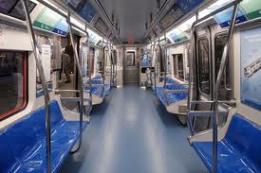
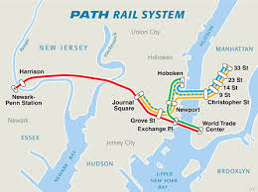
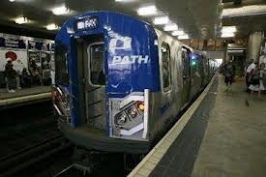
PATH
Notes:
30 PATH train connects lower Manhattan and Midtown to Jersey City, Hoboken and Newark. Most built 110 years ago. Rise of automobile travel and construction of bridges and tunnels sent original operator into bankruptcy in 1954. Port Authority agreed to buy from receivership in early 1960s, part of deal that cleared way for construction of the original World Trade Center. Much, much smaller than NYC subway system but still one of biggest 10 or 20 subway systems in the country.

Slide 31
PATH Closure Economic Consequences
Riders take longer, alternative routes (above)
or, increasingly, choose to telecommute (right).
Notes:
31 Benefitted from fact that PATH disruptions estimated right after Sandy. Needed estimates to apply for federal recovery funding. Process: take origins and destinations. Cluster them into route groups. Estimate next-best transport options for each group. Repeat exercise for clusters of time and day. Weekday rush hour was its own snapshot. Weekday non-rush was a second. Weekend was third. Building blocks for impact to travel time disruption. Adjust for remote work assumptions, bottom right.

Slide 32
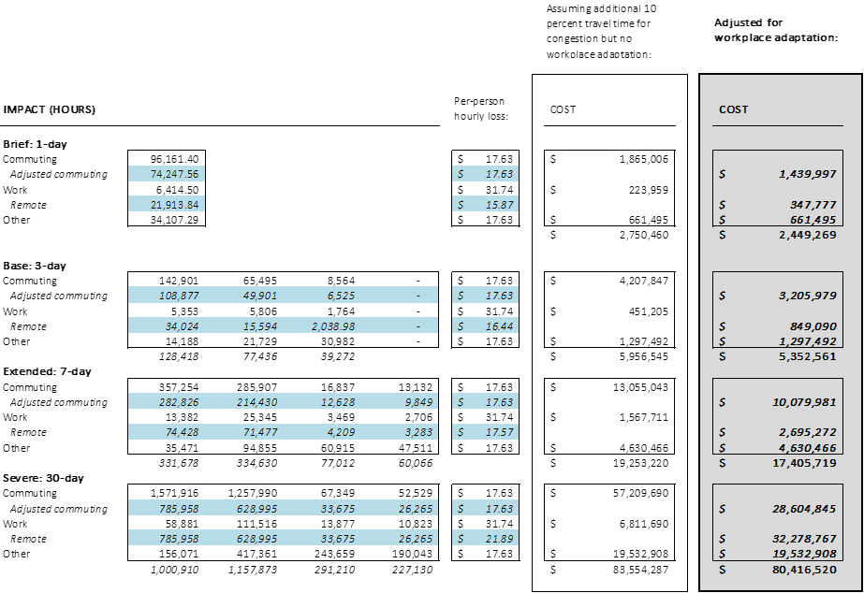
PATH Closure Economic Consequences
Notes:
32 Summary results surprised some in agency. Like transit and protective. But reminder that PATH is small portion of regional transit and subway network. Had done this for NYC subway system, very different results. Compare PATH (fraction of transit network) to tunnels, bigger share of regional transport network and one with freight implications. Then compare both to port or airport, where PANYNJ assets have monopoly over regional services in respective markets. PATH had smallest estimated impact but shouldn’t be surprising.

Slide 33
Resources and Conclusion
The US Office of Management and Budget, US Department of Transportation, and US Federal Emergency Management Agency are among the many institutions worldwide that publish guidance used for estimating economic impact from loss of service at transport facilities.
Synopsis
Adverse weather events directly affect infrastructure and disrupt economic activity
Impacts accrue in addition to asset replacement cost
Investments in resilience need to consider the full cost of asset damage and economic damage from disruption
Cost-Benefit Analysis can help capturing these adverse impacts and disbenefits
Notes:
33 Restatement of objective and scope. Public decision-makers regularly need to prioritize infrastructure projects or make discrete yes/no choice on a project.
The business case for those projects can be soft and qualitative or can be data-driven and formal, or anything in between. Climate-resilience projects aim to protect infrastructure, not only to avoid physical damage but also to protect the service those assets provide. Managers and lawmakers face the question of how to quantify the value of protecting those services.
This is not a challenge that’s easy to answer but methodology from social cost-benefit analysis provides the means to rationally value those services. This helps decision makers understand the value a given resilience project can provide.

Slide 34
Questions
What are the two key ways to estimate and measure a major storm’s impact on transportation infrastructure?
How does cost-benefit analysis apply these estimates and what does it aim to do?
Name one key assumption that might need to be taken to estimate the impact of an operational disruption to a transportation facility.
What metrics might be used to estimate an operational disruption to an airport?
Where can one go for technical guidance in estimating these impacts?
Notes:
33 Restatement of objective and scope. Public decision-makers regularly need to prioritize infrastructure projects or make discrete yes/no choice on a project.
The business case for those projects can be soft and qualitative or can be data-driven and formal, or anything in between. Climate-resilience projects aim to protect infrastructure, not only to avoid physical damage but also to protect the service those assets provide. Managers and lawmakers face the question of how to quantify the value of protecting those services.
This is not a challenge that’s easy to answer but methodology from social cost-benefit analysis provides the means to rationally value those services. This helps decision makers understand the value a given resilience project can provide.

Slide 35
Contact information:
Alexander Heil, PhD
Vice President, Research
Citizens Budget Commission
aheil@cbcny.org
[Formerly Chief Economist of PANYNJ]
Contact information:
Chris Eshleman
Planning & Regional Development Department
The Port Authority of New York and New Jersey
ceshleman@panynj.gov

