Slide 1
Public Transportation Post COVID-19
”Never let a good crisis go to waste” Winston Churchill
Presentation for AIA NJ By Suzanne DiGeronimo FAIA
February 25, 2021

Slide 2
IDEA CONTENT
TRANSIT DELIVERS - cargo pods and transit’s new retail
ALL PURPOSE STREETS - market, hub, recreation, garden
MAINTENANCE IN THE SPOTLIGHT - new bus and rail cars
BIKE SUPERHIGHWAYS
DIGITALLY ENABLED TRANSIT
MULTIPURPOSE NEIGHBORHOODS

Slide 3
Public Transportation Played a Vital Role COVID-19 Lockdown
Provided bus and rail service for essential workers to get to pharmacies, grocery stores, and all the other places we who stayed Home needed for support.
The crisis underscored how important is functional transit
To keep people
To keep deliveries moving
Available, affordable, accessible to all equitably
That keeps riders safe from violence
That provides clean stations, vehicles, fleet
Sanitized transit

Slide 4
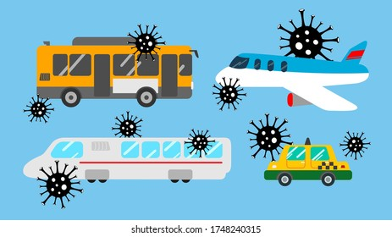
WHAT WORKED?

Slide 5
EVOLVING STREETS
Dining in the open on the sidewalk and streets
Church services at the neighborhood stoop
Streets closed to recreation to augment overcrowded parks
Biking pathways, connecting streets
Queuing for buses, stores, groceries, pharmacy, health clinics, vaccines
Delivery services
Socialization
Internet equipped school buses, parked, bringing the web to the kids

Slide 6
EVOLVING HOMES
The new commute:
School is home
Office is home
Parents are home
Children are home
Workouts are home
Worship is home
Entertainment is home
Recreation is home
Shopping is home
Deliveries are to homes
Family and neighbors forming Pods

Slide 7
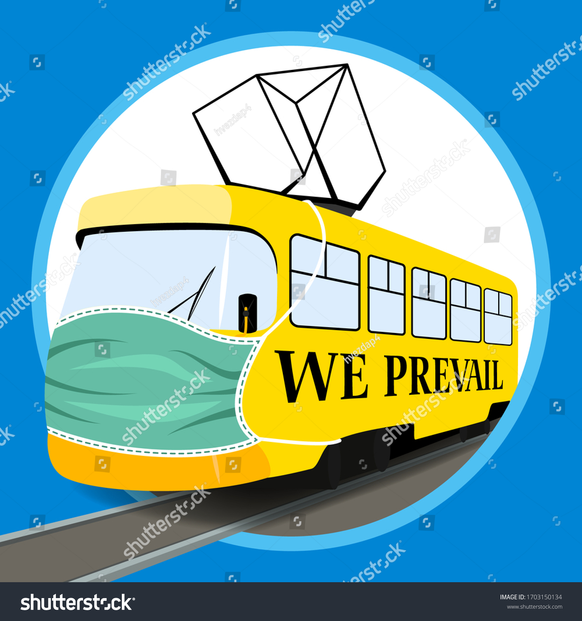
EVOLVING TRANSIT
Cleaning and disinfecting, nightly
Air cargo is strong
Shipping seaport cargo strong
Juggling transit service coverage with fewer subways, trains, buses (because transit employees have Covid)
Maintaining distancing at lesser occupancy capacity
Reduction in car transportation, clean air, less pollution

Slide 8
Looking backward to what worked, What’s ahead?

Slide 9
IDEA CONTENT
TRANSIT DELIVERS - cargo pods and transit’s new retail
ALL PURPOSE STREETS - market, hub, recreation, garden
MAINTENANCE IS IN THE SPOTLIGHT - new bus and rail cars
BIKE SUPERHIGHWAYS
DIGITALLY ENABLED TRANSIT
MULTIPURPOSE NEIGHBORHOODS

Slide 10
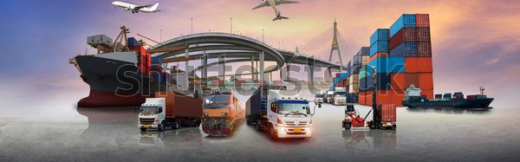
TRANSIT DELIVERS
AMTRAK, NJ Transit, MTA, and PATH partners with USPS, UPS, and FedEx
Think: mail subway cars, mail cars on trains
Think: mini-Post Offices at the end of a train platform or in part of the train station –delivered by transit rail mail
Think: delivery pick-up at the station

Slide 11
Transportation’s new Retail
Retail had been the savior of historic train stations
In-store Retail the new dinosaur
Order online, pick up in the store near you on your transportation way
Transportation stores become local fulfillment centers
larger storage, holding, employee stock room spaces;
and smaller customer display spaces

Slide 12
IDEA CONTENT
TRANSIT DELIVERS - cargo pods and transit’s new retail
ALL PURPOSE STREETS - market, hub, recreation, garden
MAINTENANCE IS IN THE SPOTLIGHT - new bus and rail cars
BIKE SUPERHIGHWAYS
DIGITALLY ENABLED TRANSIT
MULTIPURPOSE NEIGHBORHOODS

Slide 13
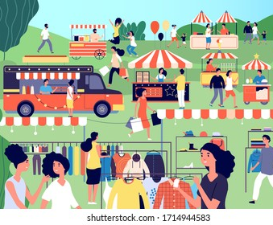
MARKET STREETS
Open air bazars, carts, selling vans, tents, restaurants
Providing a sense of community
Providing social interaction
Shop locally, help revive our small business economy

Slide 14
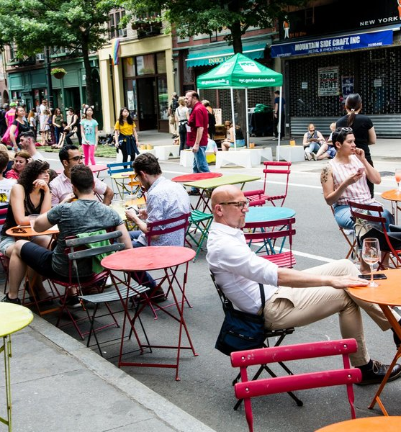
STREETS as HUBS
For Restaurants, for sales of goods, for socializing
For queuing for buses, for retail, for for pharmacies, for vaccines, for pick-up
Streets made narrower
Streets requiring changes to zoning, curbs, streets, sidewalks
And with more people on the street, our streets will be safer

Slide 15
RECREATION STREETS
Different from commuting
Walking with no destination, rambling along streets
Purely enjoying being out
Response needs benches, mini-parks, play equipment, trees, vegetation

Slide 16
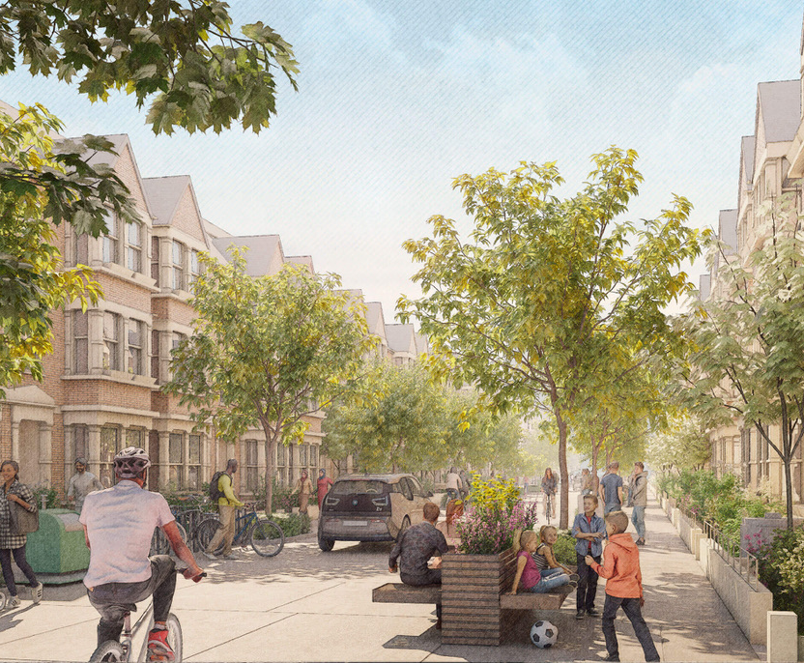
GARDEN STREETS
The Guardian a London publication, retained four architects to envision streets post-COVID.

Slide 17
IDEA CONTENT
TRANSIT DELIVERS - cargo pods and transit’s new retail
ALL PURPOSE STREETS - market, hub, recreation, garden
MAINTENANCE IS IN THE SPOTLIGHT - new bus and rail cars
BIKE SUPERHIGHWAYS
DIGITALLY ENABLED TRANSIT
MULTIPURPOSE NEIGHBORHOODS

Slide 18
FINALLY! MAINTENANCE GETS RESPECT
Appreciation for transit maintenance workers and transit employees who held the crisis line
Maintenance mattered most
Clean, disinfected transit
Maintenance of air filtration, airflow
Maintaining ventilation systems

Slide 20
CROWD CONTROL
Transit staff to ensure trains buses are not packed, not overcrowded.
Transit will be uniformly loaded, people evenly spaced, new car limits on capacity met
Computers redirect system, shifts in placing stock to those stations experiencing more people, needing more cars, more buses.
Public transportation will be more local, local bus service between neighborhood pods
Reducing occupancy in offices will scatter peoples’ commuting over a variety of time periods. Public transportation will be distributed more evenly throughout the day

Slide 22
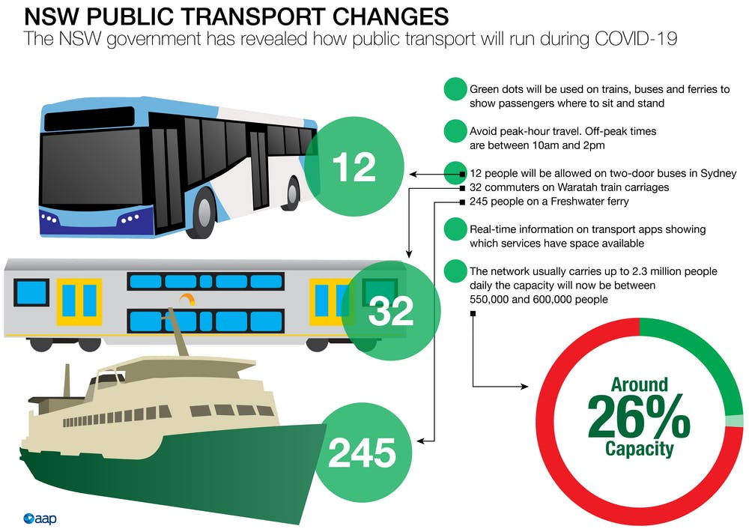

Slide 23
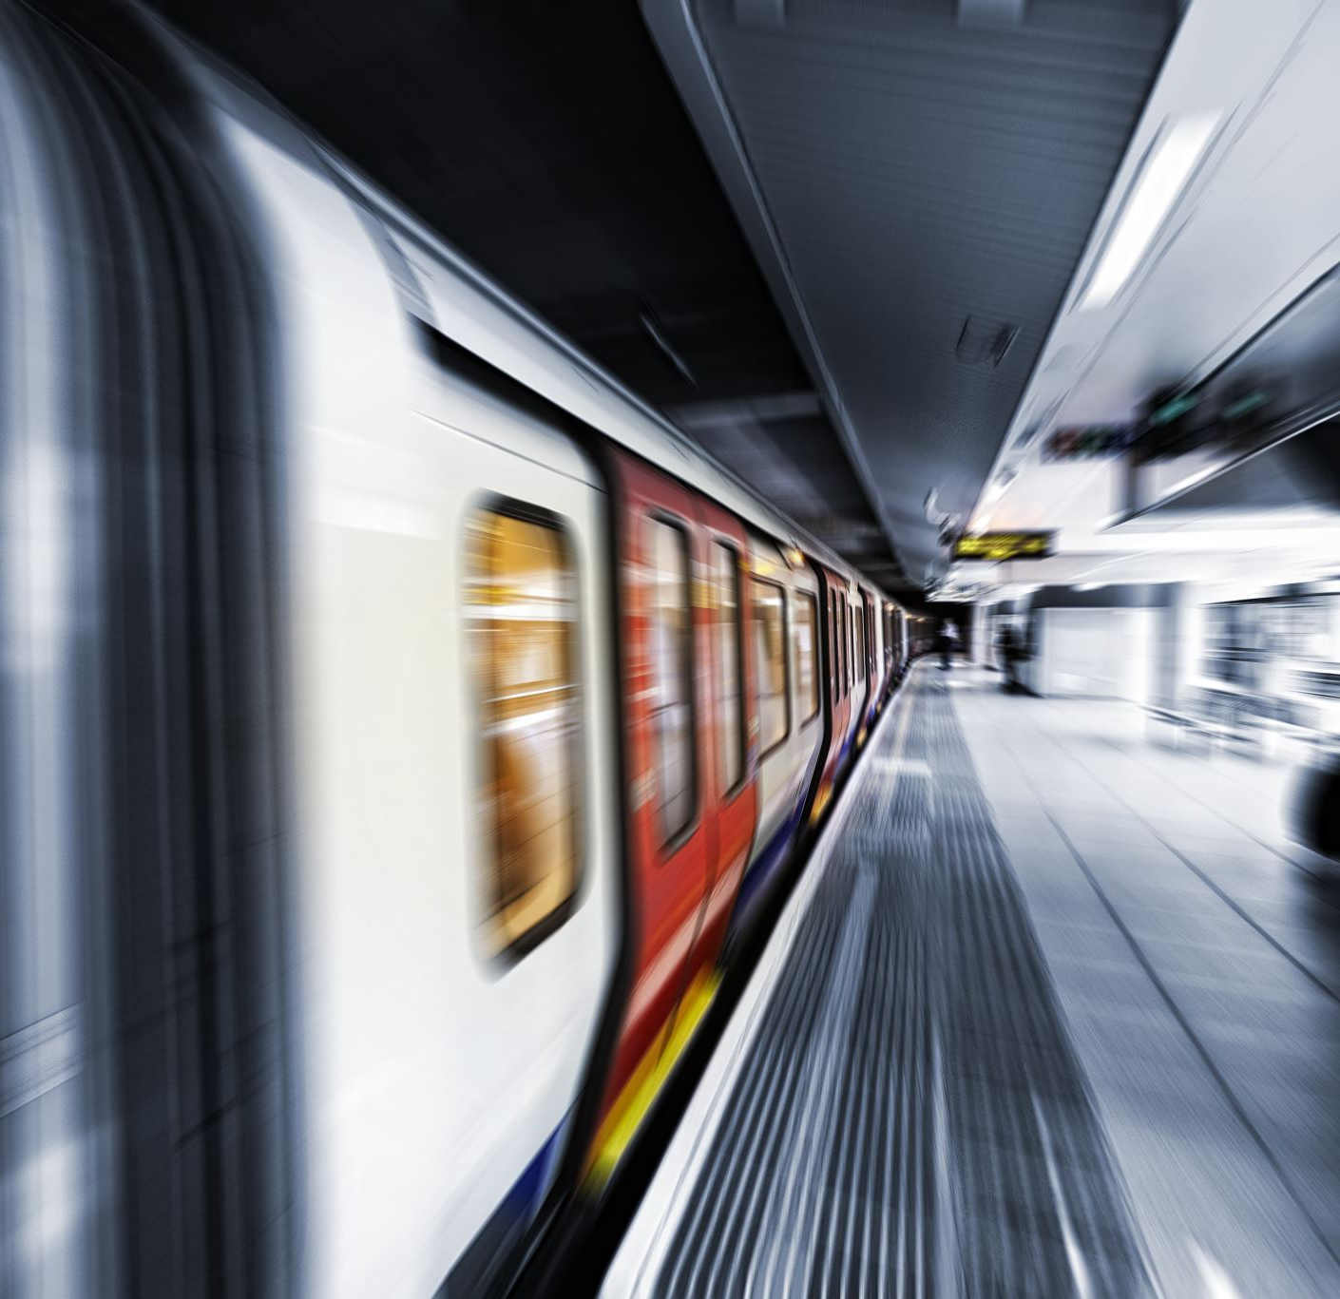
THE NEW BUS AND RAIL CAR
Dividers, walls, barriers instead of the open gang subway cars, trains, and the open gang bus
More openness in indoors bus stations, train stations, more sanitizing stations
More sunlight. Sanitizing stations and freestanding handwashing sinks
Rolling stock will have operable windows for ventilation

Slide 25
IDEA CONTENT
TRANSIT DELIVERS - cargo pods and transit’s new retail
ALL PURPOSE STREETS - market, hub, recreation, garden
MAINTENANCE IS IN THE SPOTLIGHT - new bus and rail cars
BIKE SUPERHIGHWAYS
DIGITALLY ENABLED TRANSIT
MULTIPURPOSE NEIGHBORHOODS

Slide 26
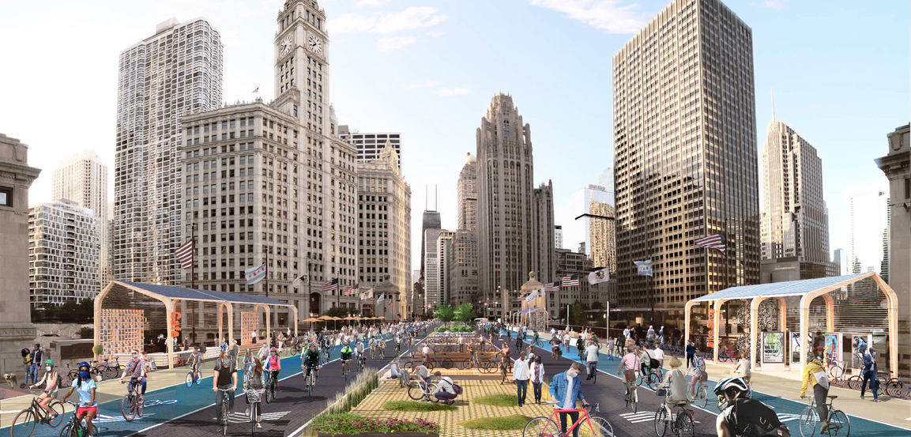
BIKE SUPERHIGHWAYS

Slide 27
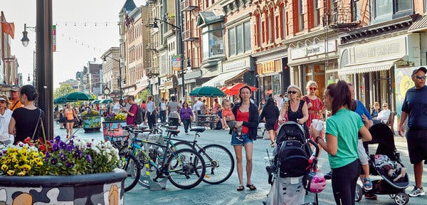
The National Highway Administration will shift funding to the edges of roads to protect pedestrians and cyclists.

Slide 28
IDEA CONTENT
TRANSIT DELIVERS - cargo pods and transit’s new retail
ALL PURPOSE STREETS - market, hub, recreation, garden
MAINTENANCE IS IN THE SPOTLIGHT - new bus and rail cars
BIKE SUPERHIGHWAYS
DIGITALLY ENABLED TRANSIT
MULTIPURPOSE NEIGHBORHOODS

Slide 31
IDEA CONTENT
TRANSIT DELIVERS - cargo pods and transit’s new retail
ALL PURPOSE STREETS - market, hub, recreation, garden
MAINTENANCE IS IN THE SPOTLIGHT - new bus and rail cars
BIKE SUPERHIGHWAYS
DIGITALLY ENABLED TRANSIT
MULTIPURPOSE NEIGHBORHOODS

Slide 33
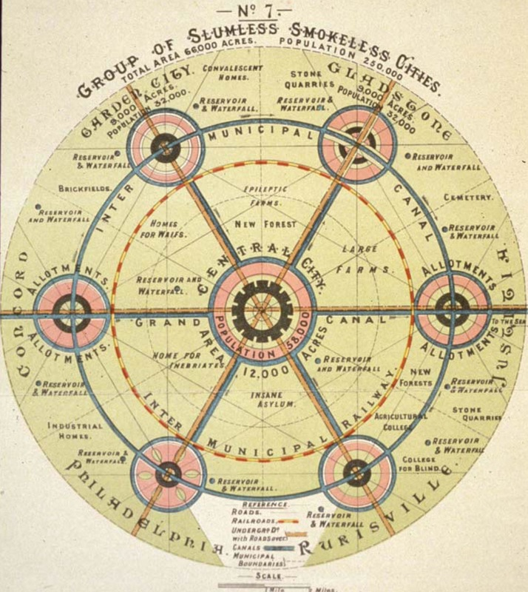

Slide 35
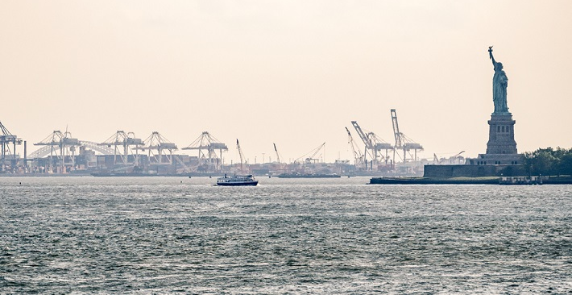
Cargo Pods
The new strong transportation goods sector is airports and seaports
Warehouses
Light industrial (breaking down large shipping containers into smaller delivery deliverable sorted packages
Fulfillment centers
Expanding around the neighborhoods near you

Slide 36
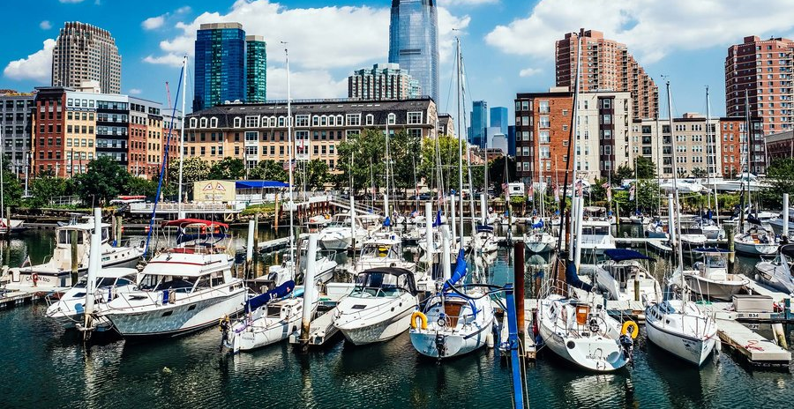
Corporate Headquarters
Offices, and therefore employees will be more distributed
Not all employees crowded into the Headquarters building
Local office fulfillment centers

Slide 37
IDEA CONTENT
TRANSIT DELIVERS - cargo pods and transit’s new retail
ALL PURPOSE STREETS - market, hub, recreation, garden
MAINTENANCE IS IN THE SPOTLIGHT - new bus and rail cars
BIKE SUPERHIGHWAYS
DIGITALLY ENABLED TRANSIT
MULTIPURPOSE NEIGHBORHOODS

Slide 38
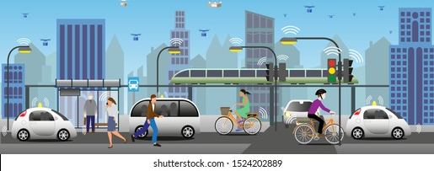
Thank you
Suzanne DiGeronimo FAIA

